Slide 1

Instructor update
Facilitated by: Lynn madison

Slide 2

Welcome - Who’s here – and why
New pre-license instructors
Existing instructors who have not taught in the last renewal period
  pre-license instructors
  continuing education instructors

Slide 3
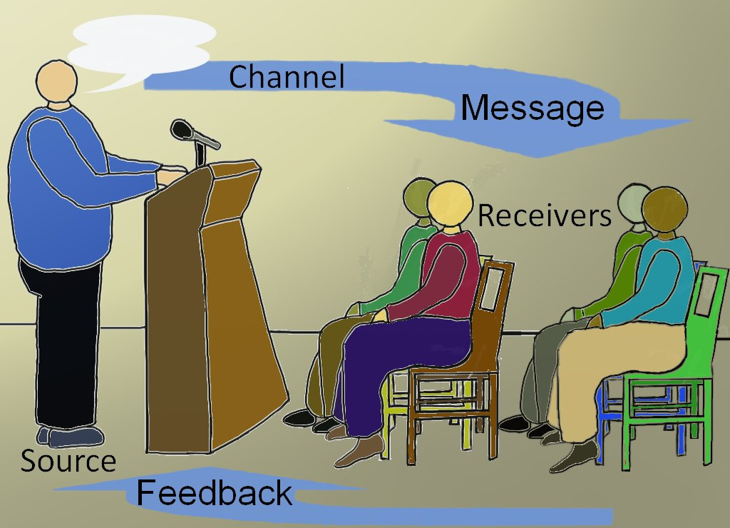
What will we do today?
AM: License Law Update
Issues often misunderstood
PM: The Power of the Platform

Slide 4

Section 5: License Act
Who Needs a License?
Sells, exchanges, purchases, rents or leases real estate
Offers to do the above
Negotiates the above
Supervises or attempts to collect rents
Advertises or represents themselves as doing any of this
Assists or directs in procuring or referring leads or prospects
Assists or directs in the negotiation of any transaction
Opens real estate to the public for marketing purposes
Offers real estate at an auction

Slide 5

Selling, leasing property they own.
Employee of owner of property
Attorney under a POA
Receiver, trustee in bankruptcy, or other court order
Resident manager for the owner
Officer or employee of the government in conduct of official business
MLS
Railroads and other public utilities – in connection with their position
Advertising companies

Slide 6
Sponsoring Broker
Person
Sole Proprietor
Entity
LLC
Partnership
Corporation
Self-Sponsored

Slide 7

Legal and Licensed Structure
Entity
Self-Sponsored
Managing Broker license renewal every two years
    ...and….
Good Standing with Secretary of State
  October 31 every year
Managing Broker license renewal every two years

Slide 8

What’s in a Name?
Licensed Name vs. Advertised Name
Assumed Name Certificate
  Register in County
  Submit Certificate to IDFPR
Branch must be licensed
  Clear relationship with main office
Diminutive of licensee name – send letter

Slide 9

Office Set Up
Definite office/place of business
  In Illinois
  Separate from other business
Signage!!
  Professional in appearance
  Outside – semi-permanent and reasonably readable by the public
  Listing in building directory OK
Register change of address

Slide 10
Timely Notifications
11
45 day permits
24 hours
Terminated license
2 days
Change of office location
Immediately
Change in escrow bank
10 days

Slide 11

IDFPR
Issue and renew licenses
Authorize license exams
Prepare forms and applications
Conduct office examinations
Investigate alleged violations
Conduct enforcement hearings
Impose discipline on licensees

Slide 12
Discipline of Licenses
Cheating on exam
Failing to properly maintain escrow accounts
Improper guaranteed sales program
Practicing without a license
Dishonorable, unethical or unprofessional conduct
False or fraudulent representations
Directly negotiating with client of another licensee
Blind advertising
Disciplined by another state
Violating Illinois Human Rights Act
Advertising property without consent of owner
Failing to disclose licensee status in transaction
Representing broker other than sponsoring one
Habitual use of alcohol and drugs

Slide 13
License Law Review
Spend 10 minutes reviewing Section 20-20 of the Illinois Real Estate License Act to familiarize yourself with the grounds for discipline.
Real Estate License Act

Slide 14

2016 findings - WITH THANKS TO Chris READ
On Site Examinations and Broker Verifications = 250
IC agreement – minimum provisions 78
Written consent for price change 72
IC agreement – signed and dated 71
IC agreement – must have 66
Disclosure of Designated Agent 63
Company and licensees licensed 60

Slide 15
2016 findings
On Site Examinations and Broker Verifications = 250
Licensee interest on sales contract 60
Changes to contract initialed 58
Agreement includes anti-discrimination clause 49
Internet advertising accurate and truthful 49
Exclusive agreements in writing 48
Disclosure and Consent to Dual Agency 44

Slide 16
2016 findings
On Site Examinations and Broker Verifications = 250
Minimum provisions in agreement 41
Binding contract on heading 41
Implementation of policy & procedures 38
Radon disclosure 38
Escrow reconciliation 34
Lead paint disclosure 33

Slide 17
2016 FINDINGS
Diminutive of licensee name 31
Record keeping for five years 31
Agreements signed and dated by seller and managing broker 30
Real Property Disclosure 28
Signage 24

Slide 18

2016 Findings
Total exams 250
Findings 1087
No findings 20
IC Agreements 215 19.8%
Contracts 200 18.4%
Listing Issues 199 18.3%
Licensing/office 184 16.9%
Agency Disclosure 107 9.8%
Other Disclosures 99 9%
Advertising 49 4.5%
Escrow records 34 3%

Slide 19
Employment Agreements
5
Be Specific – referral only? Do Rentals? Property management? Commercial?
Need agreement with yourself if LLC or Corp
Duties
Supervision
Compensation
Duration
Termination
Must be signed by all parties and dated
Can have specific end date – doesn’t have to but must have how terminated or renewed

Slide 20
Agency facts
Presumed to be agent of person we are working with
Presumed to be doing Designated Agency unless policy is different
Must disclose possibility of Dual Agency if company allows it
No-Agency is Ministerial Acts
Dual Agency needs written permission of both sides

Slide 21
Agency disclosure
Designated Agency
No-Agency
Dual Agency
When
Forms
Agent of seller at
Why
When
Why
Forms
Permission from seller at time of listing
Permission from buyer prior to showing
Confirmation from both at time of contract
Not the same as Dual
Agency – different duties
Agent selling or renting their own property
counseling – confidential
info

Slide 22
License Law Review
Please spend 15 minutes reviewing Article 15 of the Illinois Real Estate License Act to familiarize yourself with the agency relationships and disclosure required in Illinois.

Slide 23

teams
Hold themselves out to the public as a team
All transactions go through the team leader
Brainstorm pricing, strategies, etc.

Slide 24

Cannot be fraudulent, deceptive, misleading
Considered misleading if possibility it will be misunderstood by normal consumer
No cash inducements for referrals
Can offer incentives to potential clients
Disclosure of licensee status when buying, selling or leasing
    Must be on contract as well!

Slide 25

Social media
Cannot advertise other brokerage company’s listings
  Includes Facebook, Instagram, Craig’s list, etc.
Illinois Law does not agree with Code ‘one-click’ (SOP 12-5)
Only Listing and Selling offices can say they ‘sold’ a property (SOP 12-7)

Slide 26
License Law Review
Please spend 20 minutes reviewing Sections 1450.715 and 1450.720 of the Illinois Real Estate License Act – Administrative Rules to familiarize yourself with the advertising rules and requirements.

Slide 27

Who owns those photos?
Work for Hire Agreement
Brokerage Owns Photos
1
Assignment Agreement
Photographer Owns
Assigns right, title and interest to brokerage
2
Exclusive License Agreement
Photographer Owns
Grants specific use license (for sale- sold, agent marketing, etc.)
3

Slide 28

DMCA – Digital Millennium Copyright Act
The DMCA is a federal copyright law that exempts website owners from copyright infringement liability for infringing works that are posted to the website owner’s website by third parties.
Designate Copyright Agent with Copyright Office and identify Agent on website
  Must be done by 12/31/17 and every three years thereafter
  Must use Digitized Agent Registration Process

Slide 29
DMCA
Must comply with Takedown Procedure
  Requests sent to Copyright Agent
  Must remove when requested
No knowledge of infringing activity
May not receive direct financial benefit
  Includes infringing activity being a draw to your website

Slide 30

Responsibilities to clients - sellers
CMA
Net Sheet
Minimum Services
Disclosure of Compensation

Slide 31

Responsibilities to clients - buyers
CMA
Disclose anything you know that does not violate laws
Held to what a reasonably competent agent should know

Slide 32

Disclosure issues
Seller’s Property Disclosure
  Still need:
    Haven’t occupied in last 12 months
    Selling ‘as-is’
    Short sales

Slide 33

Disclosure issues
Radon disclosure
  ‘For-sale’: always - regardless of date built
  ‘For-rent’: only if landlord knows and doesn’t remedy
Lead-Paint
  Prior to 1978 – on all residential
    Includes multi-use
    Includes rentals

Slide 34

Contract issues
Contract supersedes MLS
No blanks to be filled in later
Dates must work!
No contract without delivery

Slide 35

Contemporaneous offers
Discuss process with buyers at counseling
Must get permission from #1 if they have already written
If they say ‘no’ – must refer #2
Check company policy – many cannot do this at all

Slide 36

negotiating
License law
  Present all offers in timely manner
  Cannot interfere with listing brokerage
Everything else comes from the Code of Ethics
  Must know – and teach – the Code requirements

Slide 37
Standard of Practice 1-6
REALTORS shall submit offers and counter-offers objectively and as quickly as possible
  Time limit in contract or put one in
  No response from listing agent
  Listing agent cannot hold offers except at sellers’ direction

Slide 38
Standard of Practice 1-7
  Back-up contract does not give seller right to ‘kill’ first contract.
  Must be written ‘subject to release of prior contract’ or seller needs to consult attorney
  It is not a back-up unless it is signed and noted as a back-up
  Buyer needs to ensure he meets contingencies:
    Earnest money delivery
    Loan dates
    Home inspection issues
    Insurance issues
REALTORS shall continue to submit all offers and counter-offers until closing unless seller has waived this obligation in writing.

Slide 39
Standard of Practice 3-6
REALTORS shall disclose the existence of accepted offers, including offers with unresolved contingencies, to any broker seeking cooperation.
Note: Does not require disclosure of back-up contracts
  Includes home-sale and home-closing contingent contracts
  Must report to MLS according to rules
  Must disclose during interim to anyone wanting to show

Slide 40
Standard of Practice 1-13
  Buyer agent – inform buyers of this
  Seller must give direction – agent cannot decide on his or her own
  No control over buyer if it is an Exclusive Agency listing
  Buyers should request Seller's sign confidentiality agreement prior to presentation of offer
Reads (in part) that buyers must be told ….the possibility that sellers or sellers’ representatives may not treat the existence, terms, or conditions of offers as confidential unless confidentiality is required to law, regulation, or by any confidentiality agreement between the parties.

Slide 41
Standard of Practice 1-15
Part A:
REALTORS, in response to inquiries from buyers or cooperating brokers shall, with the sellers’ approval, disclose the existence of offers on the property.
  Sellers decide whether to disclose multiple offers.
  Listing agent has duty to explain pros and cons.
  Do not have to disclose to all

Slide 42
Standard of Practice 1-15
  Buyer agents – ASK!
  Listing agents do not have to disclose who the co-op broker is – just that it is a co-op broker who has the offer
  Not over if offer is not accepted – buyer can change something (price?) and it becomes new offer
Part B:
Where disclosure is authorized, REALTORS shall also disclose, if asked, whether offers were obtained by the listing licensee, another licensee in the listing firm, or by a cooperating broker.

Slide 43
Standard of Practice 3-4
  Affirmative obligation to disclose
  Check MLS rules for how
  Disclosure is MLS is all they need to do
  Buyer agent must ask whether variable is an issue
  Buyer agent must ask about differential
  Listing agent must disclose if asked
REALTORS acting as listing brokers, have an affirmative obligation to disclose the existence of dual or variable rate commission arrangements.

Slide 44
Listings not in MLS
  No offer of compensation made to the co-op brokerage if it is not in the MLS
  Buyer broker needs something in writing from the listing Managing Broker – e-mail is sufficient
  Should have written offer of compensation prior to showing the property
All MLS’s have requirements for the inputting of listings. There may be times that the listings are not in the MLS or not in the MLS yet.

Slide 45

Earnest money and Escrow
Deposited next business day
Reinforce importance of timely delivery
Timely disbursements
  Transfer from escrow to closing agent up to 2 business days prior to closing
  Need joint written direction of parties on terminated contract
  Disbursed next business day after form signed provided check has cleared – NOT MANAGING BROKERS

Slide 46
Earnest money and Escrow
15
Disputed Escrow Money – hold until:
  Court order
  You file interpleader
  Written notice giving 14 day notice of intention to disburse – provided such language is in the sales contract and no written objection is received . . .
Unclaimed earnest money
  6 months – CAN turn it over to State
  5 years – MUST turn over to state

Slide 47
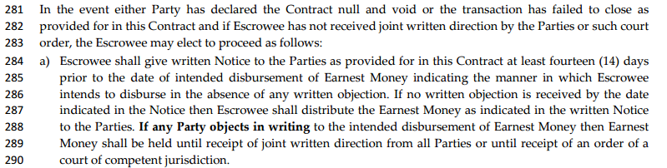
Contract language for release
15

Slide 48
Not Holding Escrow?
Attorneys and title companies have different rules
Not all attorneys will hold
Title companies usually charge – who will pay?
Have responsibility to ensure it was delivered

Slide 49

From contract to close
Must report sale to MLS on time
  Not after earnest money is delivered
  Not after home inspection is done
  Not after attorney modification is done

Slide 50

Listing Agent meets appraiser
Buyer Agent meets home inspector
Appraisal package – bring with or send before
- comps used - sales contract
- comps not used - school info
- improvements - floor plans, plat maps
Unless seller is allowing inspector and buyer only
- Do not follow - Do not point out anything
- Do not interfere - Can head off problems

Slide 51

Home inspection issues
In areas where attorneys are used
  It is the agents responsibility to handle the home inspection issues
  Attorneys don’t know if there were multiple offers – asking for too much could kill sale
  Attorneys don’t know if buyer got a really good deal and condition was reflected in price

Slide 52


Don’t Want
Do want

Slide 53
Equipment and room set-up
Be
Be there early
Check
Check room size, height, set up
Eliminate
Eliminate potential distractions
Adjust
Adjust temperature and lighting
Test
Test equipment, mics and sound system

Slide 54

Get a feel for your audience
Ensure all material is there
Be prepared for emergency
Final check on appearance

Slide 55
your intro
Set the stage
Create enthusiasm
Audience involvement
Setting expectations

Slide 56
Don’t . . .
Say
“before I begin”
Get
names wrong
Say
you’d rather be somewhere else
Admit
you’re not prepared
Tell
them they don’t want to be there

Slide 57
Rules of the room
Breaks
Washrooms
Phones
Computers
Food
What else?

Slide 58
Learning cycle
8:30 – 11
Coffee High Heavy Stuff
11 – 12
Lunch Awareness
Quick pace, fast stuff, not major issues
1:00 – 2:30
Post Lunch Recovery
Light stuff, exercises
2:30 – 4:00
Mid-Afternoon Cruise
Heavy stuff
4:00 – 5:00
Glaze-Over Syndrome
Exercises

Slide 59

Use of humor
Know when – and when not – to be funny
Story must make a point and be appropriate
Keep it clean
  Non-ethnic
  Non-disability
  Non – sexist
  No abusive language
Tell stories funny – not funny stories
Larger the audience – easier to induce laughter
More relevant – easier to recover

Slide 60
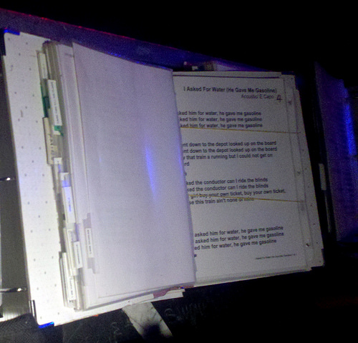
Know your material
Not your material – audit a class
Your material – own it!
Practice the PowerPoint
Follow your outline
Tell them where you are
Teach TO the exam – not FROM it
Highlight exam questions on your material
Important issues should be written

Slide 61


Your voice
A dull and A dull and
lifeless voice = lifeless presentation
Make sure they can hear you
Pleasant – no whining
Avoid meaningless sounds
Enunciate clearly
Use proper grammar
Vary your pitch and tone
Good use of inflections – emphasis on key words

Slide 62

Posture – body movement
Arrange yourself before you start
Avoid
  Grabbing lectern
  Hands in pockets
  Hands behind back
  ‘fig leaf’
  ‘sisters of mercy’
Learn to walk
  Forwards and back
  Remove obstacles

Slide 63

gestures
Helps:
  Emphasize ideas
  Create different moods
  Hold attention
  Sustain interest
Involves
  Hands
  Arms
  Head
  shoulders

Slide 64
gestures
Proportional to importance of idea
Simultaneous with point you’re making
Fit the space
Find your nervous gesture and stop it!

Slide 65

Eye contact
Look at people – not over their heads
Avoid playing to one side of the room
Pick out specific people
Don’t let notes ruin your eye contact

Slide 66
Magic ‘v’
Look at one person – everyone behind them are in the Magic V
Draw a tic-tac-toe over your group.
Look at each square – you are making
contact with everyone behind them
Don’t move too quickly work the squares randomly

Slide 67
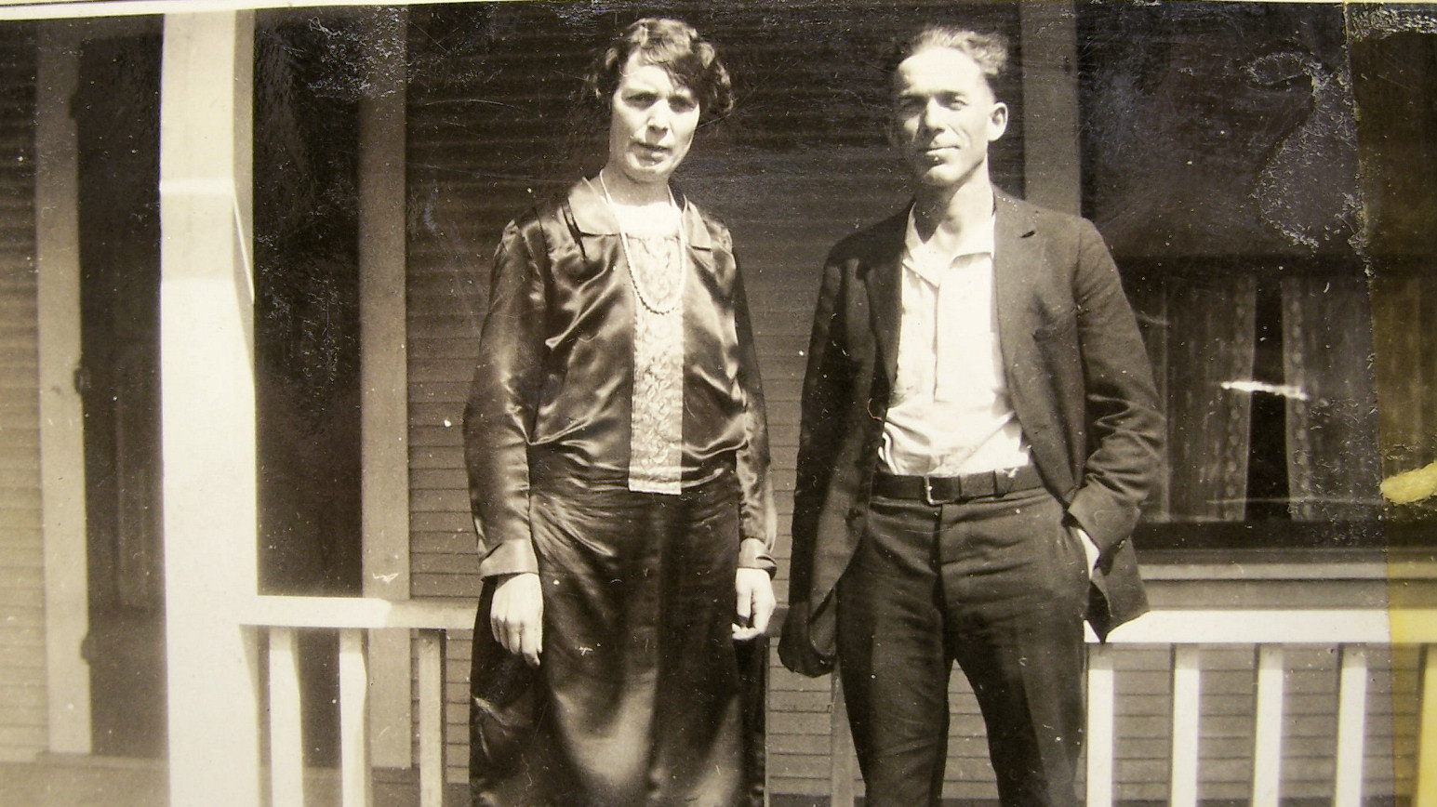
Dress to impress
Professionally – for your group
Nothing in pockets
No distracting jewelry
Shine your shoes
Neat – clean – well pressed

Slide 68
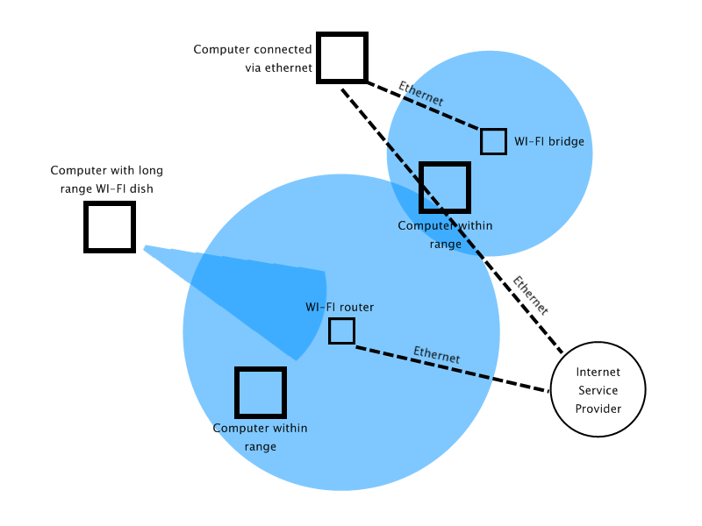

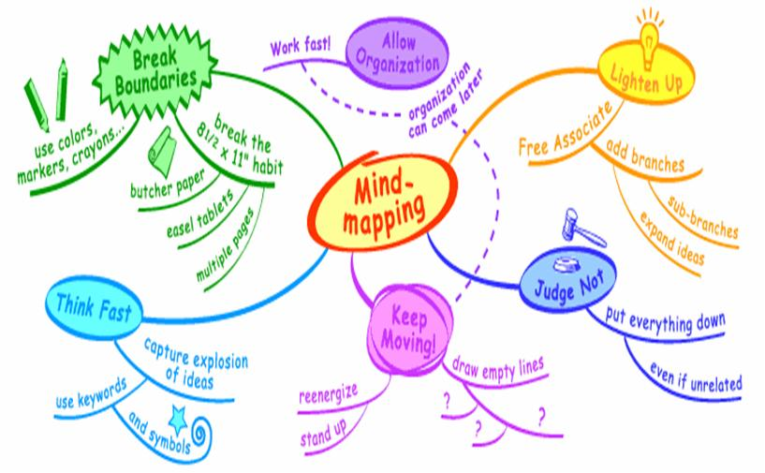
Types of learners - visual

Slide 69

physical
Learn by doing
  Using physical objects
  Role playing
  Drawing diagrams
This Photo by Unknown Author is licensed under CC BY-NC-SA

Slide 70


Types of learners
Aural
Verbal
Use sounds
  Rhythms
  Music
  Recordings
  Clever rhymes
Words – in speech and writing
  Take lots of notes
  Like scripts
  Like reading out loud

Slide 71


Types of learners
Logical
Social and Solitary
Reasoning
Systems
“Why?”
Understand BIG picture

Slide 72

Quizzes
Useful for long, complicated training
Pre-quiz for information they should already know
Post quiz to ensure they understand what you taught

Slide 73

Small group discussion & case studies
Case studies
  Analyze actual situations
Caution:
  Some will not share
  Some are just wrong!

Slide 74

Active summaries
Small group
They choose their leader
Ask them to summarize major points
Have a prewritten summary and compare

Slide 75

Q & A sessions
Informal
  Best in small groups
  Be prepared for no participation
  Good for things like:
    License law changes
    Code of Ethics

Slide 76
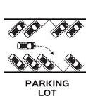
Question cards
Good for large groups
They write down their questions
Collect them – can review
Can also be accomplished with a ‘parking lot’

Slide 77

Role playing
Students assume roles
  Buyer counseling
  Listing presentation
  Negotiating
Caution
  They don’t know how!
  They don’t stay in roles
Demonstrations
Much like role plays – but done by Instructor
Works well with newer licensees
Agency Disclosures and Buyer & Seller Counseling

Slide 78
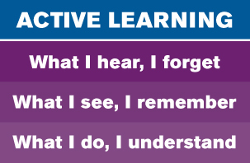
Advantages
Keeps students engaged – more receptive
Fun and enjoyable
Veterans can pass on knowledge to newer agents
Feedback to trainers

Slide 79

disadvantages
Take more time than lecture
Trainers must control
  Timing
  Going off topic
Not everybody likes it!

Slide 80

Advance planning
How will you explain the task?
  Handouts
  PowerPoint
  Verbal
Forming the groups
  Partners – good for role play
  Table mates – good for group discussion and case studies
  Mixing groups – work with other people

Slide 81

Who will lead?
Not break time – stay on task
  Instructor work the room
Time control
  Each group has ‘time cop’
  Use a timer

Slide 82
Call to order
  Let them know the signal
  Special sound / lights
Problems
  Always some confusion
  The “uncooperative”
  The “super dominant”
Reporting
  All or some
  Rules and limits

Slide 83

Read slides
74%
Full sentences
52%
Text too small
48%
Coloring
34%
Too complex
26%

Slide 84
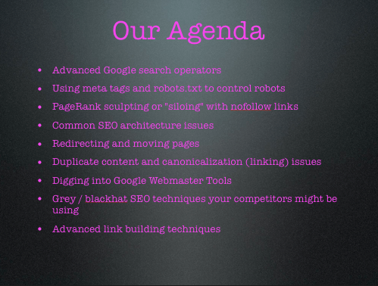
Use contrasting colors
Bad color
Too many bullets
Print too small

Slide 85
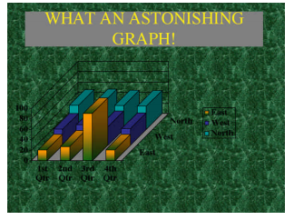
Too Complex – bad color

Slide 86
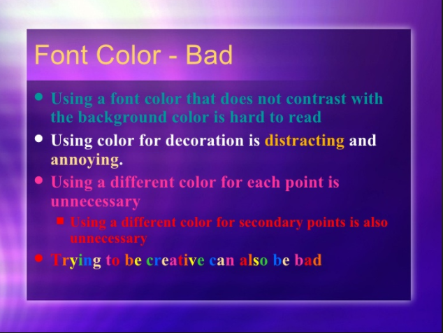

Slide 87


Stop the flying objects
They are annoying
They are distracting

Slide 88


Slide 89
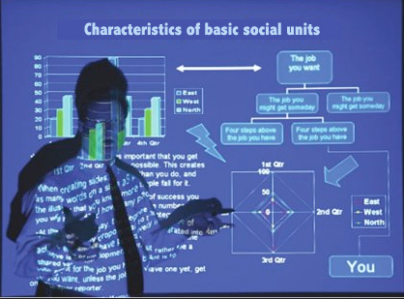
Don’t stand in front of your slides

Slide 90
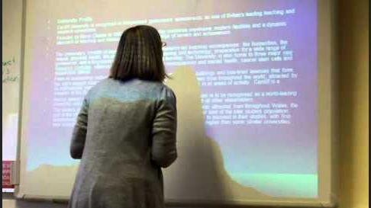
It’s pretty bad when you can’t even read what it says!

Slide 91

Structure - Timing
Not enough material for time
Too much material for time
Ran out of time

Slide 92

Handling questions
Failed to answer logically and clearly
Didn’t thank them for question
Didn’t re-state question

Slide 93
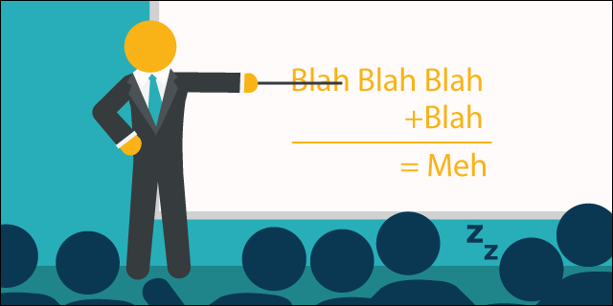
Presentation pointers
Didn’t build bridges between points
Rote – monotone – no spontaneity
Read material
Let things drag
Distracting mannerisms
Ridiculed others

Slide 94

Materials and tools
Added material – forced note taking
Unnecessary deviation from material
Jumped around – didn’t follow outline
Didn’t reinforce with visuals

Slide 95

Questions they ask you
Questions at the end – if possible
Don’t let a few dominate
Don’t let them give speeches
Repeat the questions
Have them repeat if you don’t understand
Don’t make them feel stupid
Be sure you answer it!

Slide 96

Questions you ask them
Don’t ask until they have knowledge to answer
Call on all before calling on one
Let them respond before you answer for them
Repeat student responses

Slide 97

No response
Did you ask too soon?
Ask why they are not responding
They may think you don’t want an answer
Handle it with humor

Slide 98

Difficult situations
Know-it-all or asking too many questions
  Thank them – suggest we let others talk
  Talk to them during break

Slide 99


Argues with you
I guess we’ll have to agree to disagree.
You have a point. . .
If they are wrong – be sure you make it clear to the rest of the group what the right answer is – do it tactfully but there should be no ambiguity.

Slide 100
Gives wrong answer
There was a time that might have been . . .
That’s one way to look at it – have you thought about . . .

Slide 101

Side conversations
Physically go stand by them
Address the group
Talk to them at break

Slide 102


Webinars and simulcasts

Slide 103

Summarize
Provide closure
Make it sound like a conclusion
Cue the audience
Make last words memorable
Don’t go overtime

Slide 104
The choice is yours choose wisely!
choose wisely!
The choice is yours
choose wisely!
The choice is yours
choose wisely!
The choice is yours
choose wisely!

